Slide 1
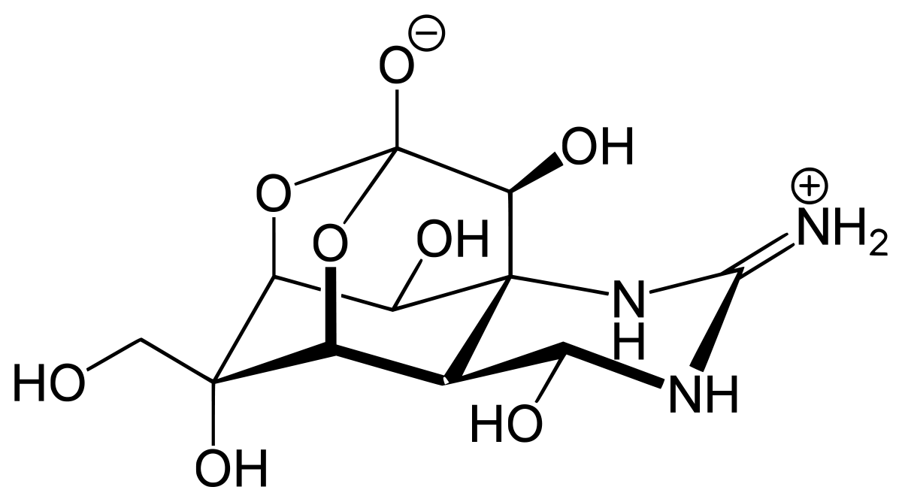
Tetrodoxin
Marvin Bäumer

Slide 2






Inhaltsverzeichnis
Herkunft
Gegengifte?
Symtome
Weiteres
Skizze
Quellen

Slide 3
Herkunft
01
Sensory neurons
Mercury is the closest planet to the Sun
02
https://fotor.com/
Motor neurons
03
Venus has a beautiful name but is hot
Interneurons
Jupiter is a gas giant and the biggest planet

Slide 4
Neuron infographics
01
Cell body
Mercury is the closest planet to the Sun
02
Nucleus
Venus has a beautiful name but is hot
03
Axon
Jupiter is a gas giant and the biggest planet

Slide 5
Neuron infographics
01
02
Jupiter
Neptune
Jupiter is a gas giant and the biggest planet
Neptune is the farthest planet from the Sun
03
04
Mercury
Mars
Mercury is the closest planet to the Sun
Despite being red, Mars is a cold place

Slide 6
Neuron infographics
Sensory neuron
Dendrites
Peripheral process
Axon
Unipolar neuron
Cell body
Central process
Mercury is the closest planet to the Sun and the smallest one in the entire Solar System

Slide 7
Neuron infographics
Dendrite
Axon terminal
Jupiter is a gas giant and the biggest planet
Neptune is the farthest planet from the Sun
Nucleus
Node of Ranvier
Mercury is the closest planet to the Sun
Despite being red, Mars is a cold place
Cell body
Schwann cell
Venus has a beautiful name but is hot
Pluto is considered a dwarf planet
Axon
Myelin sheath
Earth is the third planet from the Sun
Ceres is located in the main asteroid belt

Slide 8
Neuron infographics
01
02
03
Sensory
Pyramidal
Betz cell
Jupiter is a gas giant and the biggest planet
Mercury is the closest planet to the Sun
Venus has a beautiful name but is hot

Slide 9
Neuron infographics
Synapses
01
Mercury is the closest planet to the Sun
Excitatory
02
Venus has a beautiful name but is hot
Inhibitory
03
Jupiter is a gas giant and the biggest planet

Slide 10
Neuron infographics
The structure of microglia
Cell body
Nucleus
Microglyocyte
Mercury is the closest planet to the Sun and the smallest one in the entire Solar System

Slide 11
Neuron infographics
01
Motor
Neptune is the farthest planet from the Sun
02
Astrocyte
Despite being red, Mars is a cold place
03
Microglia
Pluto is considered a dwarf planet

Slide 12
Neuron infographics
Sensory neuron
Physical inputs
Chemical inputs
Light
Sound
Smell
Taste
Response
Jupiter is a gas giant and the biggest planet

Slide 13
Neuron infographics
Betz cell
Giant pyramidal cells
Located within the fifth layer of the grey matter
Pyramidal cells of Betz
Primary motor cortex

Slide 14
Neuron infographics
Soma
01
02
Dendrites
Jupiter is a gas giant and the biggest planet
Neptune is the farthest planet from the Sun
Axon
04
03
Axon terminals
Mercury is the closest planet to the Sun
Despite being red, Mars is a cold place

Slide 15
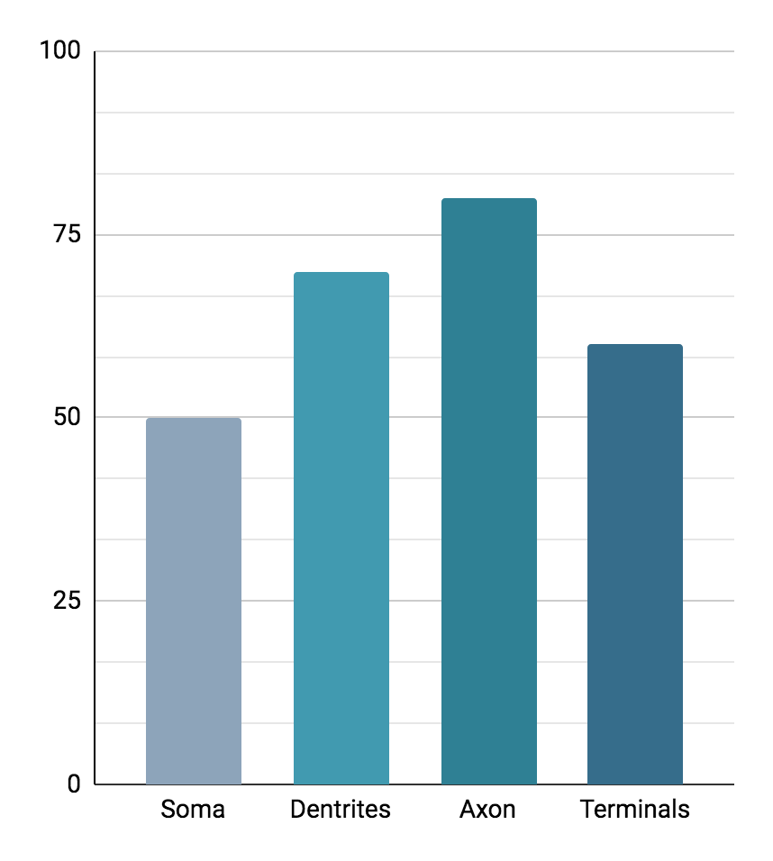
Neuron infographics
50%
70%
Soma
Dendrites
Jupiter is a gas giant and the biggest planet
Neptune is the farthest planet from the Sun
80%
60%
Axon
Axon terminals
Mercury is the closest planet to the Sun
Despite being red, Mars is a cold place
Follow the link in the graph to modify its data and then paste the new one here. For more info, click here

Slide 16
Neuron infographics
80%
Motor
Neptune is the farthest planet from the Sun
60%
Astrocyte
Despite being red, Mars is a cold place
30%
Microglia
Pluto is considered a dwarf planet

Slide 17
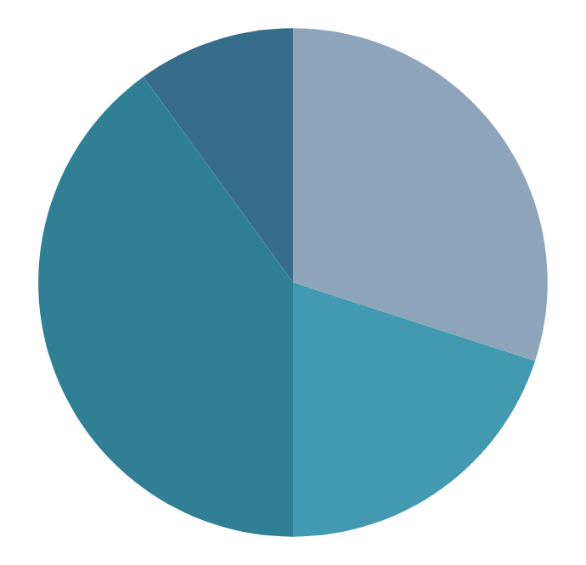
Neuron infographics
30%
20%
Soma
Dendrites
Jupiter is a gas giant and the biggest planet
Neptune is very far from the Sun
40%
10%
Axon
Axon terminals
Mercury is the closest planet to the Sun
Despite being red, Mars is a cold place
Follow the link in the graph to modify its data and then paste the new one here. For more info, click here

Slide 18
Neuron infographics
Pyramidal cells | Location | Cerebral cortex esp. Layers III and V
 | Shape | Multipolar Pyramidal
 | Function | Excitatory projection neuron
Pyramidal cells are a type of multipolar neuron | Neurotransmitter | Glutamate, GABA

Slide 19
Neuron infographics
Cell body
40%
Jupiter is a gas giant and the biggest planet
Myelin sheath
20%
Mercury is the closest planet to the Sun
Schwann cell
10%
Venus has a beautiful name but is hot
Axon terminal
30%
Earth is the third planet from the Sun

Slide 20
Neuron infographics
Synapses
Neuron
Input 1
01
Neptune is the farthest planet from the Sun
Input 2
02
Despite being red, Mars is a cold place
Input 3
03
Pluto is considered a dwarf planet
Output

Slide 21
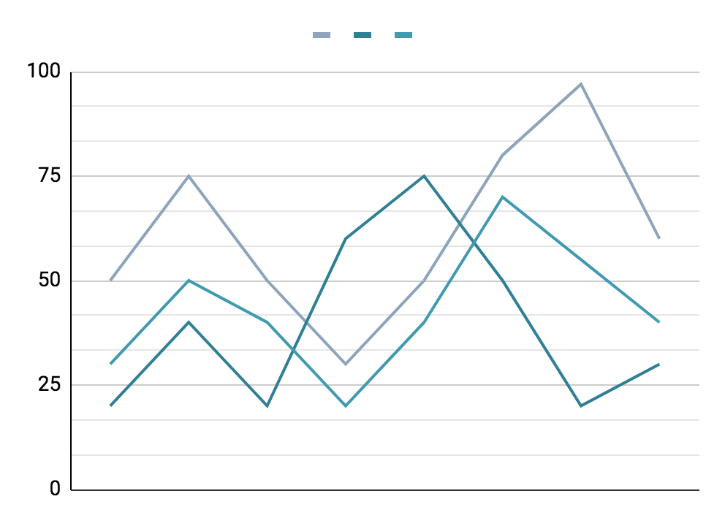
Neuron infographics
01
Synapses
Mercury is the closest planet to the Sun
02
Excitatory
Venus has a beautiful name but is hot
03
Inhibitory
Jupiter is a gas giant and the biggest planet
Follow the link in the graph to modify its data and then paste the new one here. For more info, click here

Slide 22
Neuron infographics
Soma
Axon
Dendrites
Myelin
Synapse
Despite being red, Mars is a cold place

Slide 23
Neuron infographics
75%
25%
40%
Betz cell
Astrocyte
Microglia
Mercury is the closest planet to the Sun
Despite being red, Mars is a cold place
Jupiter is a gas giant and the biggest planet

Slide 24
Neuron infographics
Excitatory
Venus has a beautiful name, but it’s hot
Synapses
Mercury is the closest planet to the Sun
Inhibitory
Jupiter is a gas giant and the biggest planet

Slide 25
Neuron infographics
Sensory neurons
Mercury is the closest planet to the Sun
Interneurons
Response
Jupiter is a gas giant and the biggest planet
Motor neurons
Venus has a beautiful name but is hot

Slide 26
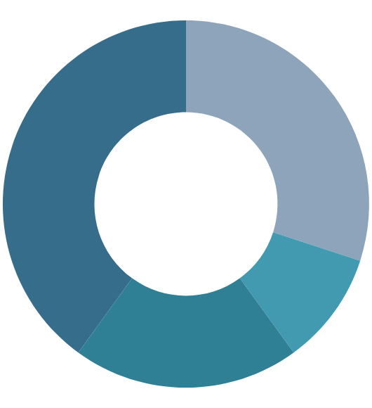
Neuron infographics
50%
70%
Soma
Dendrites
Jupiter is a gas giant and the biggest planet
Neptune is the farthest planet from the Sun
80%
60%
Axon
Axon terminals
Mercury is the closest planet to the Sun
Despite being red, Mars is a cold place
Follow the link in the graph to modify its data and then paste the new one here. For more info, click here

Slide 27
Neuron infographics
Communicating axosomatic synapses
Mercury is the closest planet to the Sun
Synapses
Communicating axodendritic synapses
Jupiter is a gas giant and the biggest planet
Communicating axoaxonic synapses
Venus has a beautiful name but it’s hot

Slide 28
Neuron infographics
Sensory neurons
75%
Motor neurons
50%
Jupiter is a gas giant and the biggest planet
Neptune is the farthest planet from the Sun

Slide 29
Neuron infographics
01
02
03
Central nervous system
Sensory input
Neural processing
Motor output
Despite being red, Mars is a cold place
Jupiter is a gas giant and the biggest planet
Neptune is very far from the Sun
3 step process

Slide 30
Neuron infographics
Microglia
Pluto is considered a dwarf planet
Regulate brain development
Resident cells of the brain
Maintenance of neuronal networks
Injury repair

Slide 31
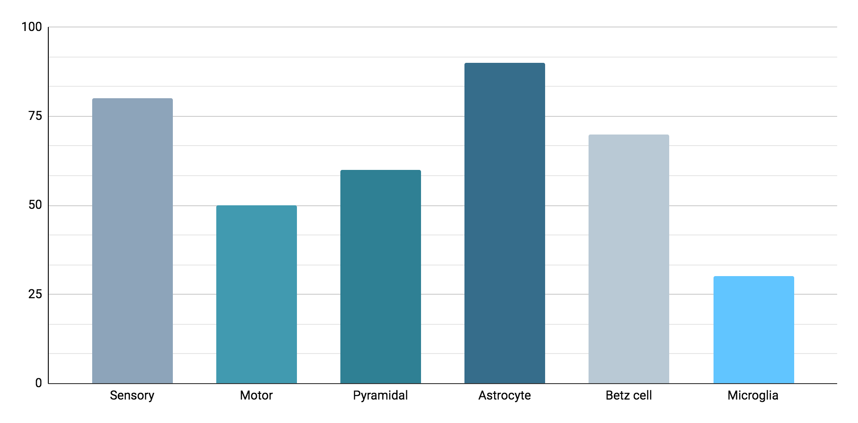
Neuron infographics
Types of neurons
Despite being red, Mars is a cold place
80%
50%
60%
90%
70%
30%
Follow the link in the graph to modify its data and then paste the new one here. For more info, click here

Slide 32
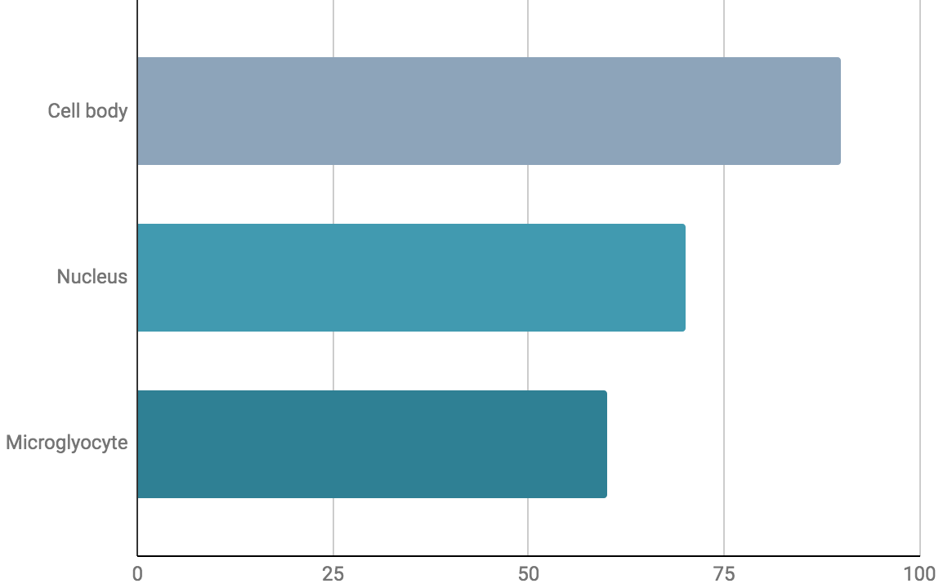
Neuron infographics
80%
70%
60%
Microglia
Jupiter is a gas giant and the biggest planet
Follow the link in the graph to modify its data and then paste the new one here. For more info, click here

Slide 33
Instructions for use
If you have a free account, in order to use this template, you must credit Slidesgo in your final presentation. Please refer to the next slide to read the instructions for premium users.
As a Free user, you are allowed to:
- Modify this template.
- Use it for both personal and commercial projects.
You are not allowed to:
- Sublicense, sell or rent any of Slidesgo Content (or a modified version of Slidesgo Content).
- Distribute Slidesgo Content unless it has been expressly authorized by Slidesgo.
- Include Slidesgo Content in an online or offline database or file.
- Offer Slidesgo templates (or modified versions of Slidesgo templates) for download.
- Acquire the copyright of Slidesgo Content.
For more information about editing slides, please read our FAQs or visit Slidesgo School:
https://slidesgo.com/faqs and https://slidesgo.com/slidesgo-school

Slide 34
Instructions for use (premium users)
As a Premium user, you can use this template without attributing Slidesgo.
You are allowed to:
Modify this template.
Use it for both personal and commercial purposes.
Hide or delete the “Thanks” slide and the mention to Slidesgo in the credits.
Share this template in an editable format with people who are not part of your team.
You are not allowed to:
Sublicense, sell or rent this Slidesgo Template (or a modified version of this Slidesgo Template).
Distribute this Slidesgo Template (or a modified version of this Slidesgo Template) or include it in a database or in any other product or service that offers downloadable images, icons or presentations that may be subject to distribution or resale.
Use any of the elements that are part of this Slidesgo Template in an isolated and separated way from this Template.
Register any of the elements that are part of this template as a trademark or logo, or register it as a work in an intellectual property registry or similar.
For more information about editing slides, please read our FAQs or visit Slidesgo School:
https://slidesgo.com/faqs and https://slidesgo.com/slidesgo-school

Slide 35
Infographics
You can add and edit some infographics to your presentation to present your data in a visual way.
Choose your favourite infographic and insert it in your presentation using Ctrl C + Ctrl V or Cmd C + Cmd V in Mac.
Select one of the parts and ungroup it by right-clicking and choosing “Ungroup”.
Change the color by clicking on the paint bucket.
Then resize the element by clicking and dragging one of the square-shaped points of its bounding box (the cursor should look like a double-headed arrow). Remember to hold Shift while dragging to keep the proportions.
Group the elements again by selecting them, right-clicking and choosing “Group”.
Repeat the steps above with the other parts and when you’re done editing, copy the end result and paste it into your presentation.
Remember to choose the “Keep source formatting” option so that it keeps the design. For more info, please visit Slidesgo School.

